Slide 1

ORT Braude College
Capstone Project Phase A – 61998
Taxi station management system
Advisor: Zeev Barzily
Student 1: Shorok Heib Student 2: Emad Suliman
ID: 315959429 ID: 322386558

Slide 2

Concise description
This project focuses on developing an efficient and organized management system for taxi stations to address current inefficiencies in day-to-day operations, including coordination between staff, booking management, driver and vehicle oversight, and performance monitoring.

Slide 3

Motivation
The project aims to improve taxi service efficiency by offering a customized solution for management teams, optimizing operations, enhancing customer satisfaction, and meeting urban transportation demands.

Slide 4
Our Solution
The solution is the Taxi Station Management System, with secretaries handling bookings and dispatch, and managers overseeing performance and making strategic decisions based on reports and analytics.

Slide 5
various tools
1. Trip Management
2. Driver Management
3. Vehicle Management
4. Scheduling and Shift Adjustments
5. Payments and Invoices Management
6. Information and Identification Systems

Slide 6
Unique Features
1. User Roles: • Manager • Secretary
2. Booking and Dispatch
3. Vehicle Management 4. Customer Management
5. Security and Authentication

Slide 7
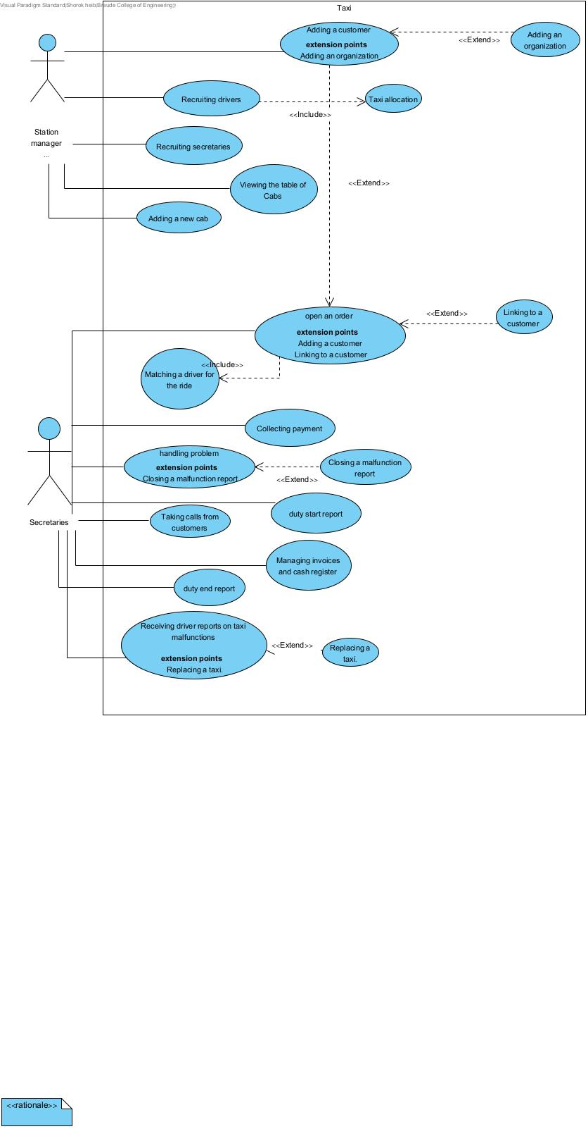
Use Case Diagram

Slide 8
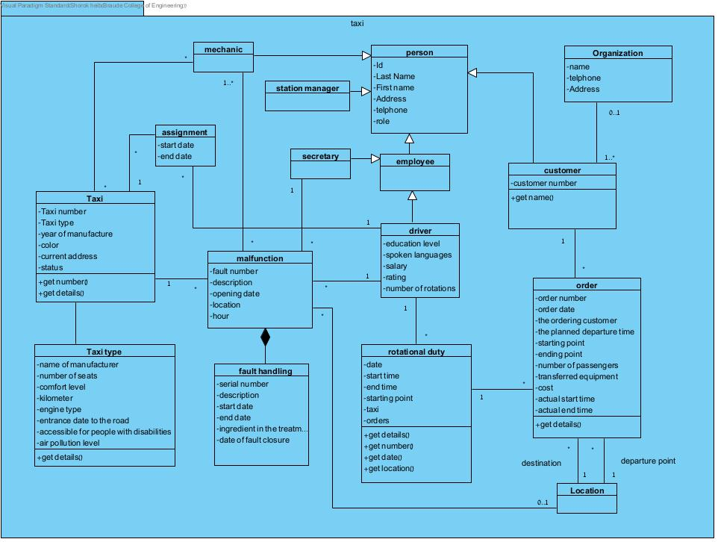
Class Diagram

Slide 9
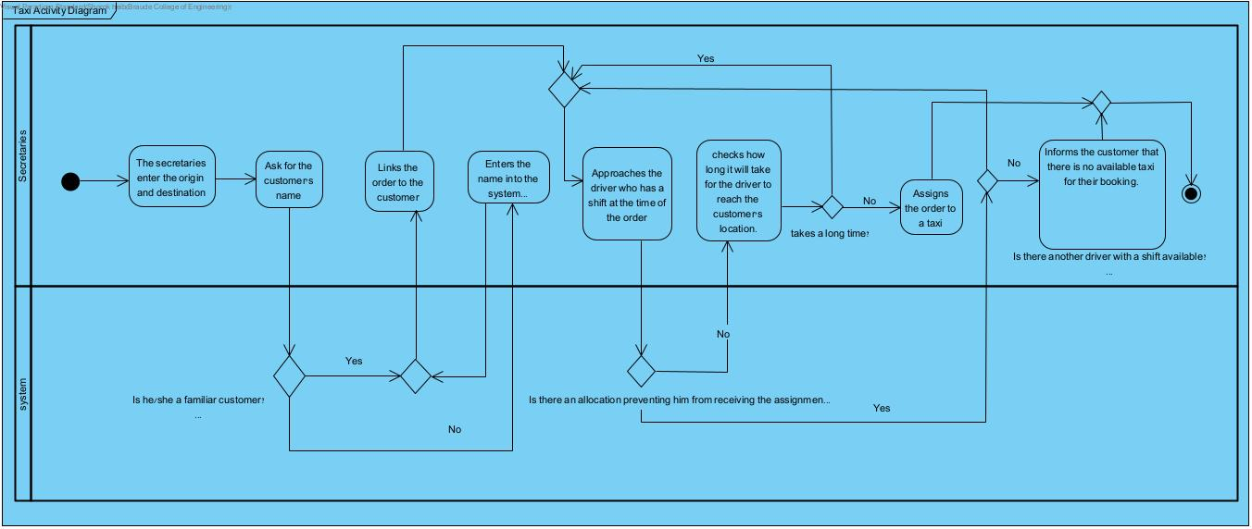
Activity Diagram

Slide 10

Challenges​
The project phase was intriguing and captivating, generating a strong foundation for system development.​
Fostered creativity and critical thinking by overcoming initial challenges.​
Time managing even if we have many tasks to do at the same time.​

Slide 11

Benefits and Insights​
Difficulty in generating a unique and brilliant idea due to the existence of similar systems in the market.​
Underestimating the complexity of developing a user-friendly system suitable for diverse users.​
Organizational difficulties arising from varying course schedules and study hours.​

Slide 12

Thank you

